Slide 1
^{Chapter 6} Graphs
ZAMAN UNIVERSITY
Data Structures and Algorithms

Slide 2
Outline
Terminology and Representations
Graph Traversals
Shortest-Paths Problems
Minimum-Cost Spanning Trees

Slide 3
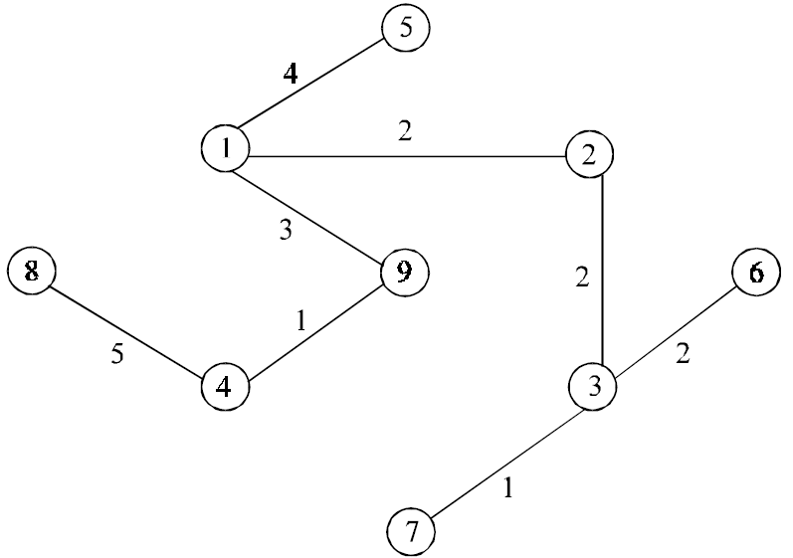
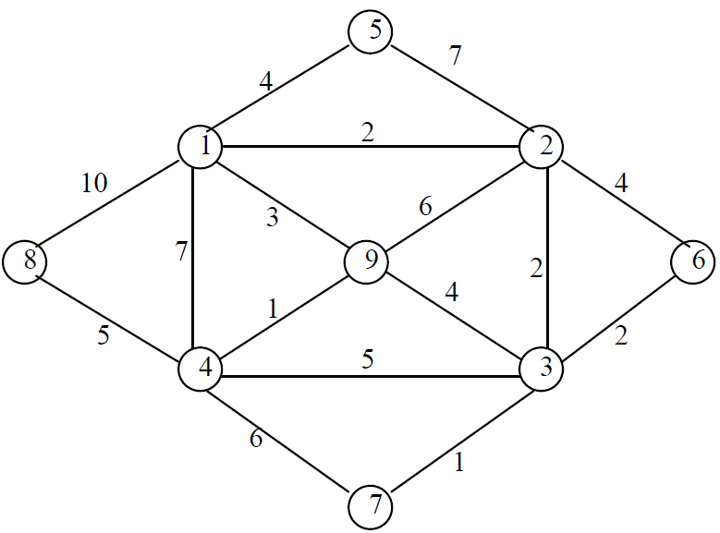
Minimum Cost Spanning Tree
A minimum spanning tree (MST) for a graph G = (V, E) is a sub graph G¹ = (V¹, E¹) of G contains all the vertices of G.
1. The vertex set V¹ is same as that at graph G.
2. The edge set E¹ is a subset of G.
3. And there is no cycle.
It connects all the vertices together with the minimal total weighting for its edges.
G =(V, E)
MST, G¹=(V¹, E¹)

Slide 4
Outline
Terminology and Representations
Graph Traversals
Shortest-Paths Problems
Minimum-Cost Spanning Trees
Kruskal’s Algorithm
Jarnik-Prim’s Algorithm
Boruvka’s Algorithm

Slide 5
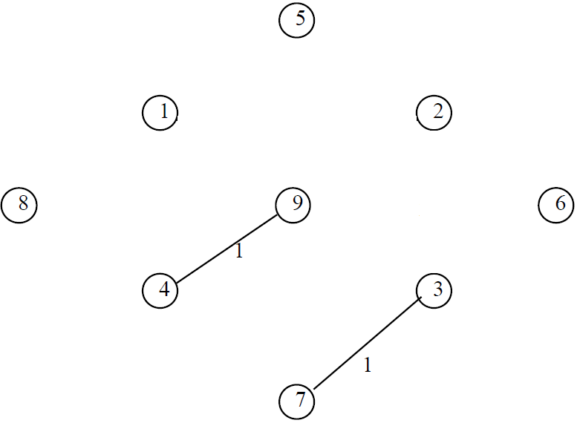
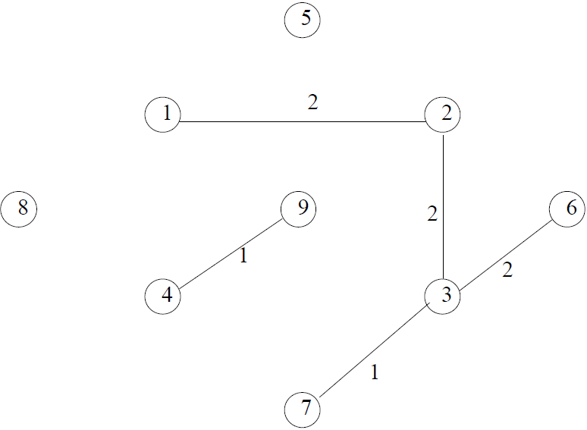
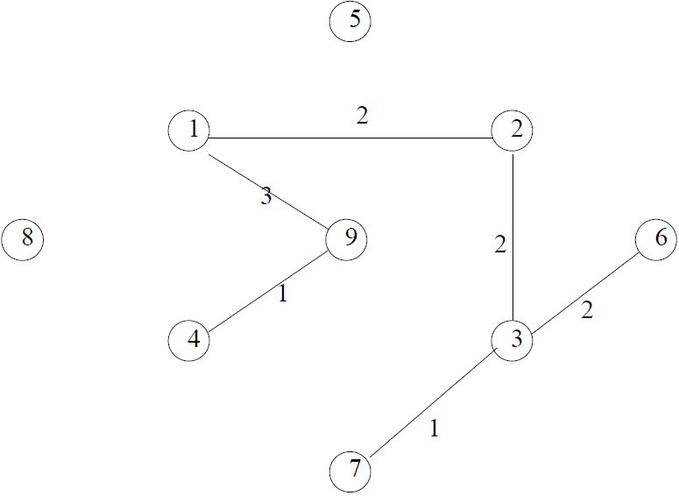
Kruskal’s Algorithm
This is a one of the popular algorithm and was developed by Joseph Kruskal
To create a minimum cost spanning trees, using Kruskalls, we begin by choosing the edge with the minimum cost (if there are several edges with the same minimum cost, select any one of them) and add it to the spanning tree.
In the next step, select the edge with next lowest cost, and so on, until we have selected (n – 1)* edges to form the complete spanning tee.
Step 1
Step 2
Step 3
Step ….
* - In case in graph, there are n edges

Slide 6
Kruskal’s Pseudo-Code
Suppose G = (V, E) is a graph, and T is a minimum spanning tree of graph G.
Initialize the spanning tree T to contain all the vertices in the graph G but no edges.
Choose the edge e with lowest weight from graph G.
Check if both vertices from e are within the same set in the tree T, for all such sets of T. If it is not present, add the edge e to the tree T, and replace the two sets that this edge connects.
Delete the edge e from the graph G and repeat the step 2 and 3 until there is no more edge to add or until the panning tree T contains (n-1) vertices.
Exit

Slide 7
More on -- http://weierstrass.is.tokushima-u.ac.jp/ikeda/suuri/kruskal/KruskalApp.shtml?demo1

Slide 8

Write functions of Kruskal (Minimum Spanning Tree) algorithm base on pseudo-code in the slide.

Slide 9
Outline
Terminology and Representations
Graph Traversals
Shortest-Paths Problems
Minimum-Cost Spanning Trees
Kruskal’s Algorithm
Jarnik-Prim’s Algorithm
Boruvka’s Algorithm

Slide 10
Jarnik-Prim’s Algorithm Pseudo-Code
Suppose G = (V, E) is a graph, which V – Set of vertex and E– Set of Edge.
1. Choose a start vertex s in G, N = {s} and A = {}
2. Add all edges connected from s to PQ (Priority Queue) by increased weight
3. Select a smallest edge from PQ which a vertex in N and another on in V\N;
- Add the selected edge to A and its (other) vertex to N
- Add all edges to PQ which connected from the recently added vertex (to N)
4. If V\N = o, then terminate. Otherwise, go to step 3

Slide 11
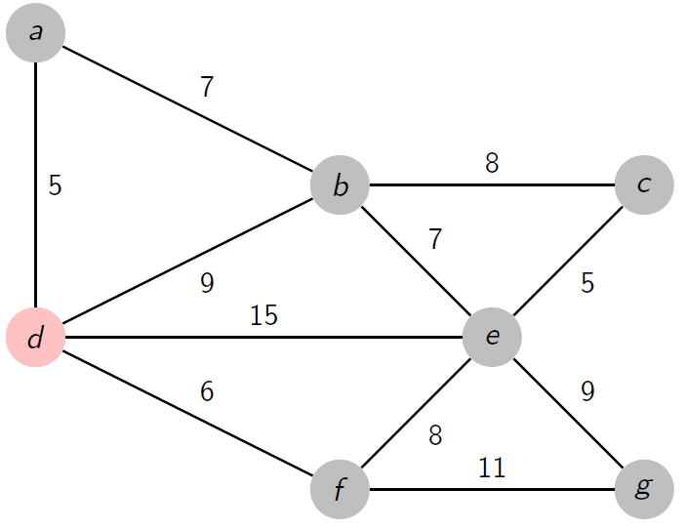
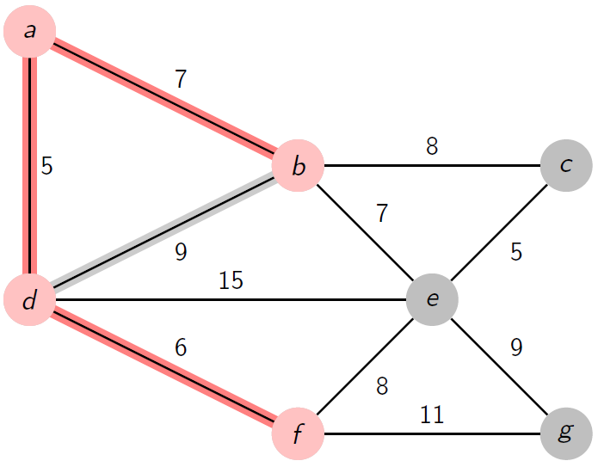
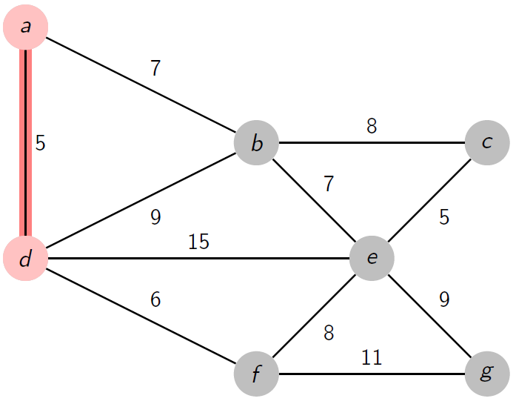
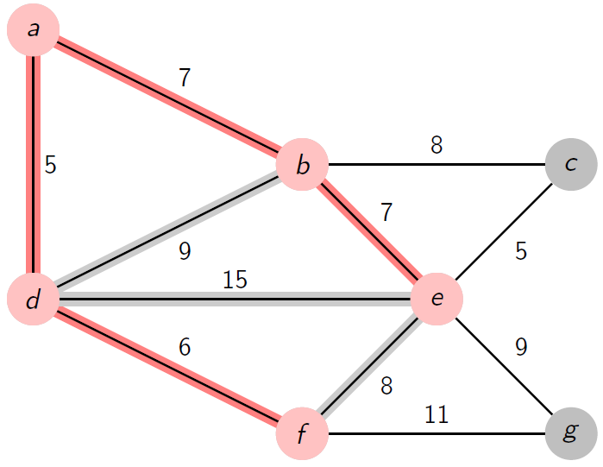
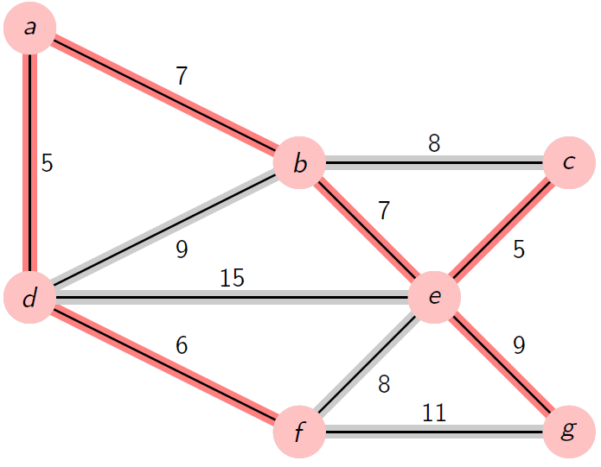
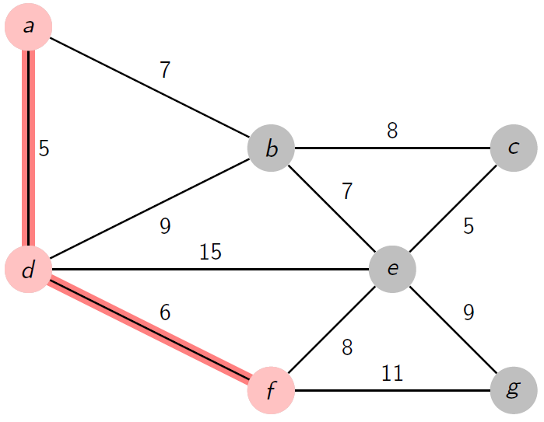
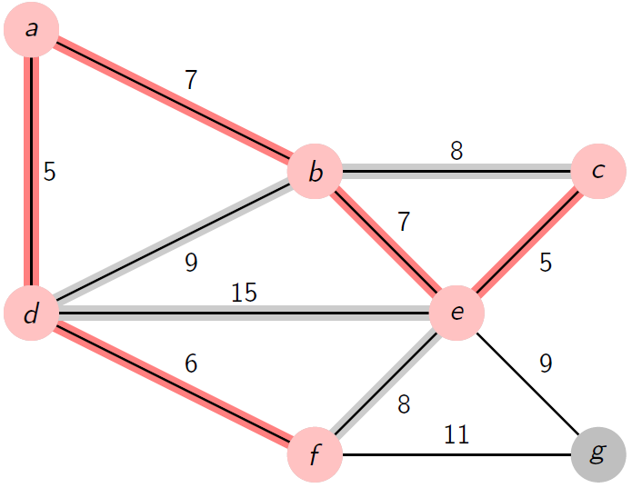
1
4
2
5
7
3
6
http://www.texample.net

Slide 12
Write functions of Jarnik-Prim’s Algorithm (Minimum Spanning Tree) base on pseudo-code in the slide.

Slide 13
Outline
Terminology and Representations
Graph Traversals
Shortest-Paths Problems
Minimum-Cost Spanning Trees
Kruskal’s Algorithm
Jarnik-Prim’s Algorithm
Boruvka’s Algorithm

Slide 14
Boruvka’s Algorithm Pseudo-Code
Initialize a forest T to be a set of one-vertex trees, one for each vertex of the graph
While T has more than one component:
For each component C of T:
Begin with an empty set of edges S
For each vertex v in C:
Find the cheapest edge from v to a vertex outside of C, and add it to S
Add the cheapest edge in S to T
Combine trees connected by edges to form bigger components
Output: T is the minimum spanning tree of G.

Slide 15
Boruvka’s Algorithm Animation
commons.wikimedia.org

Slide 16
Write functions of Boruvka’s Algorithm (Minimum Spanning Tree) base on pseudo-code in the slide.

Slide 17
To be continued…

